Slide 1



Notes:
Log into Spark Online
Click on the lesson for September 17/18 (Noah’s Ark)
Click on the Leader Guide for the lesson outline
Print to follow along
1

Slide 2
Lesson Prep Video DVD
About This Story
Why This Story Matters
About Kids
Notes:
Every lesson in the Spark curriculum has a short Lesson Prep Video to support you as you prepare to teach. A Spark team member guides you through three sections:
About This Story gives you a summary of the Bible story you will be teaching in your lesson.
Why This Story Matters explains why this Bible story is important. This part will reinforce key point in the Bible story. It will also provides some further insights into the story with historical and contextual information.
The About Kids portion of each video is all about kids! It gives you lots of tips for working with kids during your time together.
You’ll find that the About Kids section gives you helpful tips for working with the specific age level you’re teaching. It also features some of the lesson activities and gives you suggestions for enhancing what’s already in the lesson content. And you’ll hear an emphasis on the lesson focus throughout the video. This lesson focus statement is the heart of what you teach kids each week – these videos will help you see many ways that you can connect to this focus throughout the lesson.
You’ll find that these age-specific ideas will strengthen your teaching and your relationships with the kids in your class!
The video clip is a great introduction to the story and lasts for less than 5 minutes.

Slide 3
Lesson at a Glance
Scripture Reference
Lesson Focus
Lesson at a Glance with outline of each lesson activity and materials needed
Notes:
The first page of each lesson features a Lesson At-A-Glance Chart.
Featured under the each week’s lesson title are:
Scripture reference - where we will find our Bible story
Lesson Focus – everyone will know what the main point is
All the lesson activities reinforce the lesson focus. Learners will be more confident in what they have learned.
In addition, this chart shows you what kids will do and the resources and supplies you’ll need for each activity. You can quickly get a sense for the flow of your lesson by spending a few minutes with this chart.

Slide 4
Notes:
For our first lesson, Noah’s Ark, the Scripture reference is Genesis 6-9 (chapters 6-9).
The lesson focus statement is Saints and sinners, we walk on dry ground.
Life Question
Bible Memory Verse – encourage children to learn their Bible Memory Verse each week. They can earn a Faith Rock for these verses in addition to the Faith Rock Memory Verse (which officially starts in October).

Slide 5
Leader Guide
Resources & General Supplies
Notes:
Each grade level has its own leader guide with unique activities designed specifically for that age group. But there are also many common features throughout all the leader guides that make it easy to use these guides no matter what age you’re teaching!
Spark Resources and Supplies list the common supplies you’ll need throughout the quarter, like the Spark Story Bible or Spark Bible, Spark lesson stickers, coloring pages, scissors, crayons, and so on. You will find the leaflet, Spark Lesson Stickers and coloring pages in your brown teaching folder each week.
In your room there is a “cubby” with markers, scissors, glue, pencils, crayons, etc. in it.
Sometimes a lesson will require extra supplies. In your weekly teacher email, I will indicate exactly what you can expect to find in your classroom supply bin and what you may need to supply (ie a calculator or watch) from home.
Extra classroom supplies can be found in the Children’s Ministry Workroom.

Slide 6
Each Lesson
Gather
Open the Bible
Activate Faith
Send
Notes:
Each lesson is divided into 4 sections:
Gather – a time to introduce the focus of the lesson and build relationships with your class. Engages learners in an activity that they may join in as they arrive. Learners can join in the activity as they arrive. It also has a check-in feature which fosters building relationships/community.
Open the Bible - gets kids into God’s word! You’ll also find many ideas for how Spark leaflets can help bring the story to life.
Activate Faith - Games, activities, puzzles, songs, skits – all kinds of multisensory activities during this time help kids connect the Bible story to their own lives. From week to week you’ll find a variety of ways to tap into different learning styles so that each kid will find activities that engage the way they learn best.
Send Time - a time to wrap up the lesson, point out Faith on the Go! Ideas from the leaflet, and finish with a Closing Prayer. Kids are sent out with a great understanding of how God’s story is their story! Closing prayer…I really encourage you to end class with a prayer. It brings back our focus on God and models for our learners what they can do at home. The kids can pray.

Slide 7
First lesson
Gather
Notes:
Set out name tags and activity pages at the tables.
As children arrive, ask parents to sign their child in on the blue attendance card
Children should find a place at the table and start making their name tag. It should include First and Last name. We need everyone to wear their nametag each class time.
Invite children to sit down and work on the activity page. I will only supply these the first week and unless you ask for them.
Create class rules and review respect policy
Arrival Activity– markers & pencils in your cubby, paper in your green classroom supply bin, extra Bibles in cubby
Opening Conversation – first and second pages of leaflet
Opening Prayer –

Slide 8
Each Lesson
Open the Bible
Open the Bible
Notes:
Noah’s Ark Story – second page of leaflet; Show the class how to find Genesis 6 in their Bible (Old Testament, first Book, chapter number in orange), Spark Bible stickers are in the back of their Spark Bible
The Hazards of Ark Travel - third page of leaflet; pencils in cubby, paper in green classroom supply bin
Captain Noah’s Log – third page of leaflet, pencils are in your cubby
Remember It – fourth page of leaflet

Slide 9
Each Lesson
Activate Faith
Notes:
God Sent a Rainbow – fourth page of leaflet
The Worst Animal -
For the Birds -

Slide 10
Each Lesson
Send
Notes:
Send Time –
Closing Conversation – backpage of leaflet (Faith on the Go!)
Collect name tags and put in name tag pouch from your brown teaching folder
Closing Prayer – End class with prayer in lesson and Lord’s Prayer (posted in classroom)
Open door and invite parents to sign their child/ren out and Respect Policy

Slide 11
After Each Lesson
Any extra leaflets & stickers keep in folder, return folder to bin at Children’s Ministry Workroom
Return any additional materials to the supply bin on your table. Leave items posted on walls
Clean up room (tables and floor)
Pick up offering basket outside classroom
If you are the last class using your room, (sign outside classroom indicating what classes meet in room).
  Bring your classroom bin back to the workroom

Slide 12

Spark Classroom Bonus Materials
Coloring Pages
Lesson Extras
Art, and Wild Card
Notes:
Through our online subscription, you have access to additional content for you to tailor your lesson to fit your learners.
You will have coloring pages each week for children to do as they arrive to class
You can anticipate about 45 minutes of class time for 5:17 and 10:45 classes and 60 minutes for 9:30. As the teacher, you can pick and choose what your class will do. Know that you will be responsible for supplies for any activity that I do not include in the weekly email.

Slide 13
Spark Family Pages
Weekly Take Home Sheets
Read It
  Read and review the Bible story together
  family prayer
Talk About It
  Conversation Starters
  Ear Sparks and Eye Sparks
Live It
  Life application activities for Families,
Older Students and Younger Students
Notes:
Spark Family pages are designed to help families share in their child’s Sunday school experience and keep the learning alive through the week. It reinforces the church-home connection.
These can be found online at www.kingofkingswoodbury.org and included in the weekly email

Slide 14

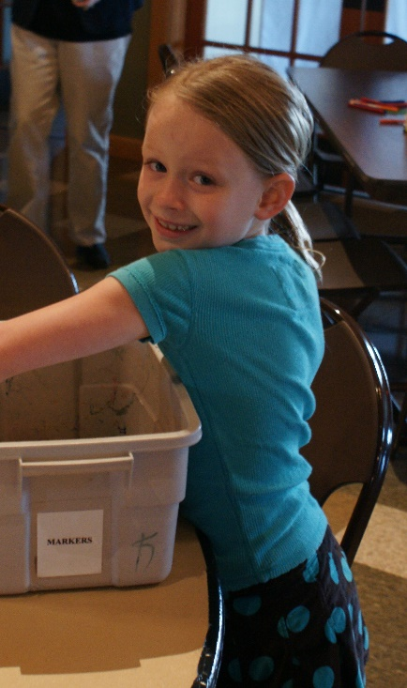
Notes:
Thank you for teaching a Kids of the Kingdom class. I hope you find it to be a rewarding experience.
Kids of the Kingdom is more than a class. It is also about creating relationships and investing our time and ourselves with the children we come into contact with.
Being an effective teacher as God is calling you to be is not only teach about God but share your faith and love with our children.
It’s not about us. It’s about helping our kids see God and that means trusting that the Holy Spirit is using us to plant the seeds of faith to help our children see God. We need to get out of the way and let God do God’s work in all of our hearts.

